Slide 1




LENDI INSTITUTE OF ENGINEERING AND TECHNOLOGY
(Autonomous)
Approved by AICTE and Permanently affiliated to JNTU Gurajada-Vizianagaram.
ECE,EEE,CSE&MECH
DEPARTMENT OF COMPUTER SCIENCE AND ENGINEERING
NAME OF THE SUBJECT :Distributed Systems
NAME OF THE TOPIC : Operating System Support
PRESENTED BY :
Mr. Satish Dekka
Associate Professor

Slide 2
Contents:
Introduction
The Operating System Layer
Protection
Processes and Threads
Address Space
Creation of a New Process
Threads.

Slide 3
Introduction
In distributed systems, the middleware applies to a software layer that provides a programming abstraction as well as masking the heterogeneity of the underlying networks, hardware, operating systems and programming languages. Some middleware, such as java Remote Method Invocation (RMI) supports only a single programming language. But all middleware deals with the operating system and hardware.
The middleware layer uses protocols based on messages b/w processes to provide its higher level abstractions. The main important aspect of middleware is the provision of location transparency and independence from the details of communication protocols, operating systems and the computer hardware. The task of any operating system is to provide problem-oriented abstractions of the underlying physical resources such as the processors, memory, communications and storage media.

Slide 4
An operating system such as UNIX or Windows-XP provides the programmer with files rather than disk blocks, and with sockets rather than raw network access. It takes over the physical resources on a single node and manages them to present these resources abstractions through the system-call interface. Both UNIX and Windows-XP are examples of network operating systems.
Middleware and network operating system: In fact, there is no distributed operating systems in general use, only network operating system such as UNIX, Mac OS, and Windows-XP.
Because of these following two reasons.
  The first reason is that the users have much invested in their application software. So they refused to adopt new operating system, whatever efficiency advantages it offers.
  The second reason is that users tend to prefer to have a degree of autonomy for their machines because of its performance.

Slide 5
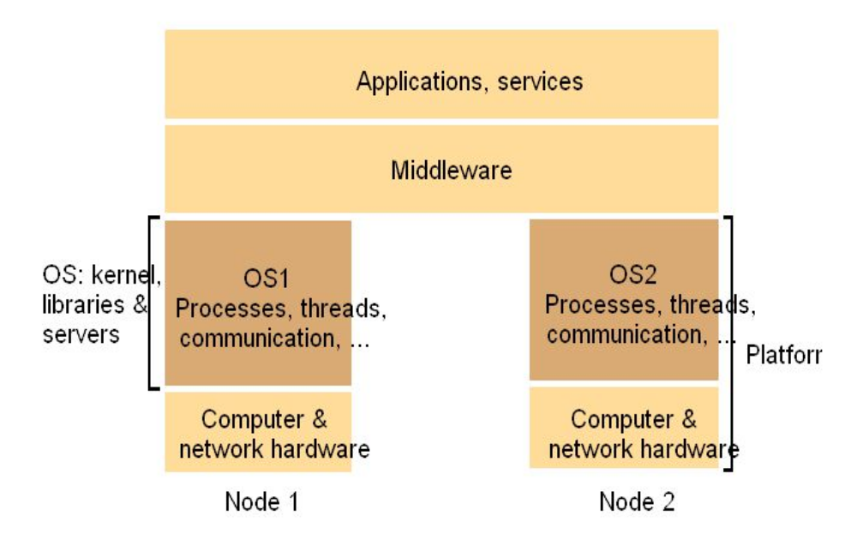
The Operating system layer:
The Operating system layer: The good performance of middleware and OS combination, the users are satisfied to distribute the data in distributed networking technology. In this case, middleware runs on a variety of OS platforms at the nodes of a distributed system. The OS running at a node with a librariy service which provides local hardware resources for processing, storage and communication.

Slide 6
The above figure shows how the operating system layer at each of two nodes supports a common middleware layer in providing a distributed infrastructure for applications and services.
Middleware and the Operating System
• Middleware implements abstractions that support network-wide programming.
Examples: • RPC and RMI (Sun RPC, Corba, Java RMI)
• event distribution and filtering (Corba Event Notification, Elvin)
• resource discovery for mobile and ubiquitous computing
• support for multimedia streaming
• Traditional OS's (e.g. early Unix, Windows 3.0)
– simplify, protect and optimize the use of local resources
• Network OS's (e.g. Mach, modern UNIX, Windows NT) – do the same but they also support a wide range of communication standards and enable remote processes to access (some) local resources (e.g. files).
Combination of middleware and network OS
• No distributed OS in general use
– Users have much invested in their application software
– Users tend to prefer to have a degree of autonomy for their machines
• Network OS provides autonomy
• Middleware provides network-transparent access resource
The relationship between OS and Middleware
– The tasks of Operating System are processing, storage and communication
– The Components of Operating System are kernel, library, user-level services
• Middleware
– It runs on a variety of OS-hardware combinations
– remote invocations

Slide 7
Functions that OS should provide for middleware
• Encapsulation – provide a set of operations that meet their clients’ needs
• Protection – Protect resource from illegitimate access. For example, files are protected from being read by users without read permissions, and devices registers are protected from application processes.
• Concurrent processing – support clients access resource concurrently
• Invocation mechanism: a means of accessing an encapsulated resource – Communication
• Pass operation parameters and results between resource managers – Scheduling
• Schedule the processing of the invoked operation

Slide 8
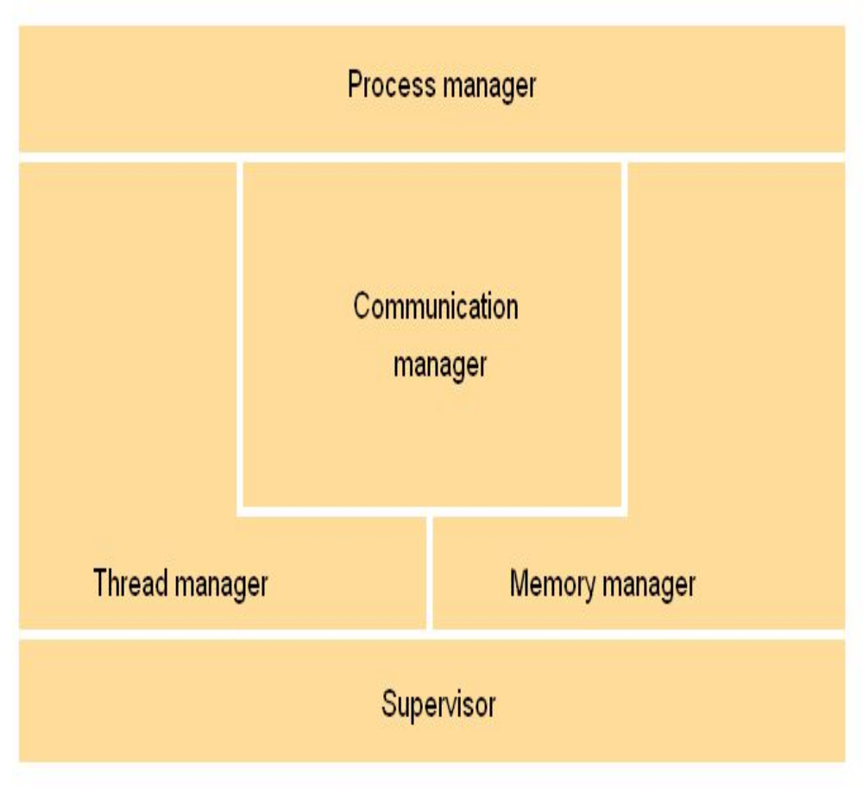
Core OS functionality:
Process manager – Handles the creation of and operations upon processes. A process is unit of resource management, including an address space and one or more threads.
Thread manager – Thread creation, synchronization and scheduling. Threads are schedulable activities attached to processes and are fully described.
Communication manager – Communication between threads attached to different processes on the same computer. Why because, some kernels also support communication b/w threads in remote processes. Other kernels require additional service for external communication.
Memory manager – Management of physical and virtual memory.
Supervisor – Dispatching of interrupts, system call traps and other exceptions – control of memory management unit and hardware caches – Processor and floating point unit register manipulations.

Slide 9
Shared-memory multiprocessors:
Shared-memory multiprocessor computers are equipped with several processors that share one or more modules of memory (RAM). The processors may also have their own private memory. Multiprocessor computers can be constructed in a variety of forms.
In the common symmetric processing architecture, each processor executes the same kernel and the kernels paly largely equivalent roles in managing the hardware resources. The kernels share key data structures such as the queue of runnable threads, but some of their working data is private. Each processor can execute a thread simultaneously, accessing data in the shared memory, which may be private or shared with other threads.
Multiprocessors can be used for many high-performance computing tasks. In distributed systems, they are particularly useful for the implementation of high-performance servers because the server can run a single program with serval threads that handle several requests from clients simultaneously. For example providing access to a shared database.

Slide 10
Protection:
  The resources require protection from illegitimate (illegal) access. For example, the file can opened in two operations, such as read and write.
  Therefore files are protected from being read by users without read permissions, and devices registers are protected from application processes.
  The other type of illegitimate access is address of file, called file pointer. For example, smith managed to access file pointer variable directly. So she constructs a (setFilePointerRandomly) operation, which sets the file pointer to a random number.
  Thus, Access the file pointer variable directly (setFilePointerRandomly) i.e Non-type-safe language vs. type-safe language.
  • Type–safe language, e.g. Java or Modula-3.
  • Non-type-safe language, e.g. C or C++

Slide 11
Kernels and protection:
The kernel is a program that is distinguished by the facts that it always runs and its code is executed with complete access privileges for the physical resources on its host computer. In particular, it can control the memory management unit and set the processor registers so that no other code may access the machine’s physical resource except in acceptable ways.
A kernel process executes with the processor in supervisor (privileged) mode. The kernel arranges that other processes execute in user (unprivileged) mode.
Different execution mode
    – An address space: a collection of ranges of virtual memory locations, in each of which a specified combination of memory access rights applies, e.g.: read only or read-write
    – supervisor mode (kernel process) / user mode (user process)
    – Interface between kernel and user processes: system call trap
    – The kernel also sets up address spaces to protect itself and other processes from the accesses of an aberrant process
    – To provide processes with their required virtual memory layout.
    – The terms user process or user-level process are normally used to describe one that executes in user mode and has a user-level address space.
    – When a process executes application code, it executes in a distinct user-level address space for that application
    – When the same process executes kernel code, it executes in the kernel’s address space.
    – The process can safely transfer from a user-level address space to the kernel’s address space via an exception such as an interrupt or a system call trap- the invocation mechanism for resources managed by the kernel.
The price for protection – switching between different processes take many processor cycles – a system call trap is a more expensive operation than a simple method call – A system call trap is implemented by a machine-level TRAP instruction, which puts the processor into supervisor mode and switches to the kernel address space.

Slide 12
Processes and Threads
A process is an active program, i.e., a program that is under execution. It is more than the program code, as it includes the program counter, process stack, registers, program code etc. Compared to this, the program code is only the text section.
When a computer program is triggered to execute, it does not run directly, but it first determines the steps required for execution of the program, and following these steps of execution is referred to as a process. An individual process takes its own memory space and does not share this space with other processes.
Processes can be classified into two types namely – clone process and parent process. A clone process, also called a child process, is one which is created by another process, while the main process is one that is responsible for creating other processes to perform multiple tasks at a time is called as parent process.
A thread is a lightweight process that can be managed independently by a scheduler. It improves the application performance using parallelism. A thread shares information like data segment, code segment, files etc. with its peer threads while it contains its own registers, stack, counter etc.
A thread is basically a subpart of a large process. In a process, all the threads within it are interrelated to each other. A typical thread contains some information like data segment, code segment, etc. This information is being shared to their peer threads during execution.
The most important feature of threads is that they share memory, data, resources, etc. with their peer threads within a process to which they belong. Also, all the threads within a process are required to be synchronized to avoid unexpected results.

Slide 13
Difference between Process and Thread
Comparison Basis | Process | Thread
Definition | A process is a program under execution i.e. an active program. | A thread is a lightweight process that can be managed independently by a scheduler
Context switching time | Processes require more time for context switching as they are heavier. | Threads require less time for context switching as they are lighter than processes.
Memory Sharing | Processes are totally independent and don’t share memory. | A thread may share some memory with its peer threads.
Communication | Communication between processes requires more time than between threads. | Communication between threads requires less time than between processes.
Blocked | If a process gets blocked, remaining processes can continue execution. | If a user level thread gets blocked, all of its peer threads also get blocked.
Resource Consumption | Processes require more resources than threads. | Threads generally need less resources than processes.
Dependency | Individual processes are independent of each other. | Threads are parts of a process and so are dependent.
Data and Code sharing | Processes have independent data and code segments. | A thread shares the data segment, code segment, files etc. with its peer threads.
Treatment by OS | All the different processes are treated separately by the operating system. | All user level peer threads are treated as a single task by the operating system.
Time for creation | Processes require more time for creation. | Threads require less time for creation.
Time for termination | Processes require more time for termination. | Threads require less time for termination.

Slide 14
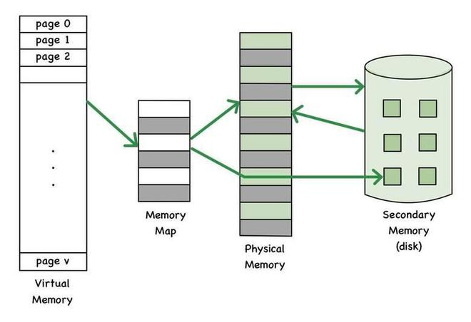
Virtual address space refers to the room of addresses which usually refers to the reference to the different slots of virtual memory allotted to different processes. Operating systems allocate this set of addresses for the processes to use in order to access their designated virtual memory.
Key Terminologies of Virtual Address Space in Operating System
Page: A page is a fixed-size memory block that is used to manage virtual memory.
Code segment: A part of a virtual address that contains the executable instructions of the process.
Data Segment: The part of a virtual address that contains the allocated memory and process variables.
Page Table: It is a data structure that the operating system manages to keep track of the relationship between virtual pages and actual memory frames.
Page Fault: This is a case scenario where the page which is requested is not present in the physical memory.

Slide 15
Advantages of Using Virtual Address Space in Operating System
  Allows efficient memory management and helps to avoid fragmentation issues
  Using this technique gives memory protection as it helps to prevent the virtual memory frames from getting accessed anonymously.
  Avoids interference between processes’ memory spaces which helps to increase the stability of the system.
  It helps to make efficient usage of the memory as it helps to share the same memory space for two/more processes.
Disadvantages of Using Virtual Address Space in Operating System
  Using the Virtual Adress Space process adds more complexity to the memory management system as there are several steps that are carried on to make it work.
  Managing the Page table is more work and it also adds to the increase in complexity of the process.
  Additional space is used to include the Page Table which maintains the mapping between the virtual and physical memory.

Slide 16
How Process Management is Done in Distributed Systems ?
Process management has different ways to share the process among all the processors, and other nodes that are a part of a distributed system. There are following 3 policies & mechanisms defined to do so let’s have a look at each of them.
1. Process Allocation
Process Allocation deals with allocating processor, or node, or some fixed size of memory to the process (size may vary as the requirements of the process increase). This is initial procedure when the process is born and is about to perform the assigned tasks.
2. Process Migration
Process migration as its name indicates, is the shifting (or migrating) the process to the desired node or processor. Migration can be done for many reasons like load balancing if the current node on which it was executing has exhausted its limit of handling a certain amount of processes at a time, or it could be for resource utilization. Process Migration is further of 2 types :
Non Pre-emptive Migration: The process is migrated before starting its execution on the source node that is, the node on which the process was born, before starting its execution it will migrate to its target node.
Pre-emptive Migration: In this case, the process has already started its execution but due to some unexpected factors or demands it needs to be migrated to other nodes. This is a costly procedure as this requires the OS to save the state of the process, all the related information like process id, files it has opened, program counter, state, priority etc to be save in the Process Control Block (PCB)
3. Threads
Threads in distributed system play a major role, dividing the process in multiple parts each having their own control flow of execution and hence achieving parallel computing. This parallel computing helps in improvising the overall efficiency of the distributed system.

Slide 17
Process Management in Distributed Systems
The process management in the Distributed System takes place through various collaborative mechanism among the processes residing in the system and it takes place with a set of steps. We’ll first have a basic overview of it and then go in its details.
Foundation of Process Management
The following tasks are the foundation of process management:
1. Process creation and termination
Creation: When the program moves from secondary memory to main memory, it becomes a process and that’s when the real procedure starts. In the context of Distributed System, the initialization of process can be done by one of the node in the system, user’s request , or required as dependency by other system’s component, forked() by other processes as a part of some bigger functionality.
Termination: A process can be terminated either voluntarily or involuntarily by one of the node in the run-time environment. The voluntary termination is done when the process has completed its task and the process might be terminated by the OS if its consuming resources beyond a certain criteria set by the distributed system.
2. Process Coordination
As a part of a whole system with multiple nodes in it, Process coordination (or otherwise known as process synchronization) becomes crucial part of managing the overall system, very frequently, our distributed system may come across the scenario when multiple process have to agree on a single decision based on some criteria. This agreement is governed by various algorithms like 2 – Phase Commit (2-PC) and 3 – Phase Commit (3-PC) algorithms.
3. Fault Tolerance
Fault tolerance is the ability of the system to give response to the client even in case of system failure. The distributed system does this by replicating the data across various nodes, so if one of the node fails for any reason like under maintenance, or down due to hardware failure then the system will fetch the data from other nodes.
4. Load Balancing
This feature roots mainly from Database management system (for delegating requests to other servers). Load Balancing is one of the major feature that forms the core of distributed system a process needs to be developed in a certain way that after reaching a pre-defined limit of request on a specific node, further upcoming requests will be handled by other nodes.

Slide 18
Thread
A thread is a single sequence stream within a process. Threads are also called lightweight processes as they possess some of the properties of processes. Each thread belongs to exactly one process. In an operating system that supports multithreading, the process can consist of many threads.
Why Do We Need Thread?
Threads run in parallel improving the application performance. Each such thread has its own CPU state and stack, but they share the address space of the process and the environment.
Threads can share common data so they do not need to use inter-process communication. Like the processes, threads also have states like ready, executing, blocked, etc.
Priority can be assigned to the threads just like the process, and the highest priority thread is scheduled first.
Each thread has its own Thread Control Block (TCB). Like the process, a context switch occurs for the thread, and register contents are saved in (TCB).
As threads share the same address space and resources, synchronization is also required for the various activities of the thread.
Components of Threads
These are the basic components of the Operating System.
Stack Space
Register Set
Program Counter

Slide 19
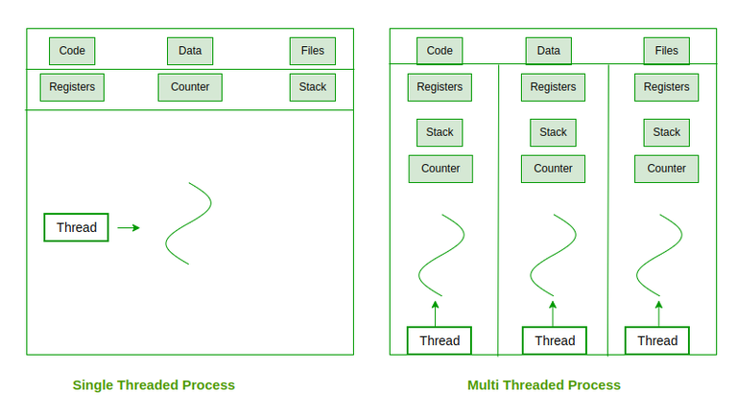

Slide 20
Distributed File Systems

Slide 21
Contents
Introduction
File Service Architecture
Peer-to-Peer Systems: Introduction
Napster and its Legacy
Peer-to-Peer Middleware
Routing Overlays.

Slide 22
Introduction
A distributed file system (DFS) is a file system with data stored on a server. The data is accessed and processed as if it was stored on the local client machine. The DFS makes it convenient to share information and files among users on a network in a controlled and authorized way. The server allows the client users to share files and store data just like they are storing the information locally. However, the servers have full control over the data and give access control to the clients.
One process involved in implementing the DFS is giving access control and storage management controls to the client system in a centralized way, managed by the servers. Transparency is one of the core processes in DFS, so files are accessed, stored, and managed on the local client machines while the process itself is actually held on the servers. This transparency brings convenience to the end user on a client machine because the network file system efficiently manages all the processes. Generally, a DFS is used in a LAN, but it can be used in a WAN or over the Internet.

Slide 23
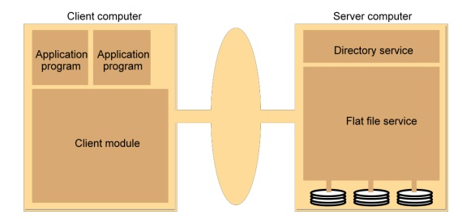
File Service architecture
File Service architecture An architecture that offers a clear separation of the main concerns in providing access to files is obtained by structuring the file service as three components:
1. A flat file service 2. A directory service 3. A client module.
The Client module implements exported interfaces by flat file and directory services on server side. Responsibilities of various modules can be defined as follows:
  ● Flat file service : Concerned with the implementation of operations on the contents of file. Unique File Identifiers (UFIDs) are used to refer to files in all requests for flat file service operations. UFIDs are long sequences of bits chosen so that each file has a unique among all of the files in a distributed system.
  ● Directory service: Provides mapping between text names for the files and their UFIDs. Clients may obtain the UFID of a file by quoting its text name to directory service. Directory service supports functions needed to generate directories, to add new files to directories.

Slide 24
Client Module: It runs on each computer and provides integrated service (flat file and directory) as a single API to application programs. For example, in UNIX hosts, a client module emulates the full set of Unix file operations. It holds information about the network locations of flat-file and directory server processes; and achieve better performance through implementation of a cache of recently used file blocks at the client.
Access control: In distributed implementations, access rights checks have to be performed at the server because the server RPC interface is an otherwise unprotected point of access to files.
Flat file service RPC interface
  Used by client modules, not user programs
    – FileId (UFID) uniquely identifies file
    – invalid if file not present or inappropriate access
    – Read/Write; Create/Delete; Get/Set Attributes
  No open/close! (unlike UNIX)
    – access immediate with FileId
    – Read/Write identify starting point
  Improved fault-tolerance
    – operations idempotent except Create, can be repeated (at least-once RPC semantics)
    – stateless service

Slide 25
Distributed File Systems: Issues
  Naming and Transparency
  Remote file access
  Caching
  Server with state or without
  Replication
Advantages:
  Access time reduced.
  Safer if node fails.
  Does not require client nodes to have large storage space.
  Disadvantages:
  Difficult to keep local copy consistent with remote copy.
  Slower than just keeping it in local memory.

Slide 26
Related requirements in distributed file systems are:
Transparency (clients unaware of the distributed nature)
  – access transparency (client unaware of distribution of files, same interface for local/remote files)
  – location transparency (uniform file name space from any client workstation)
  – mobility transparency (files can be moved from one server to another without affecting client)
  – performance transparency (client performance not affected by load on service)
  – scaling transparency
2. Concurrency: Concurrent file updates (changes by one client do not affect another)
3. Replication: File replication (for load sharing, fault-tolerance)
4. Heterogeneity : (interface platform-independent)
5. Fault tolerance: (continues to operate in the face of client and server failures)
6. Consistency : (one-copy-update semantics or slight variations)
7. Security : (access control)
8. Efficiency :(performance comparable to conventional file systems)

Slide 27
Peer-to-Peer Systems: Introduction
A peer-to-peer network is a simple network of computers. It first came into existence in the late 1970s. Here each computer acts as a node for file sharing within the formed network. Here each node acts as a server and thus there is no central server in the network. This allows the sharing of a huge amount of data. The tasks are equally divided amongst the nodes. Each node connected in the network shares an equal workload. For the network to stop working, all the nodes need to individually stop working. This is because each node works independently.
Types of P2P networks
  Unstructured P2P networks: In this type of P2P network, each device is able to make an equal contribution. This network is easy to build as devices can be connected randomly in the network. But being unstructured, it becomes difficult to find content. For example, Napster, Gnutella, etc.
  Structured P2P networks: It is designed using software that creates a virtual layer in order to put the nodes in a specific structure. These are not easy to set up but can give easy access to users to the content. For example, P-Grid, Kademlia, etc.
  Hybrid P2P networks: It combines the features of both P2P networks and client-server architecture. An example of such a network is to find a node using the central server.

Slide 28
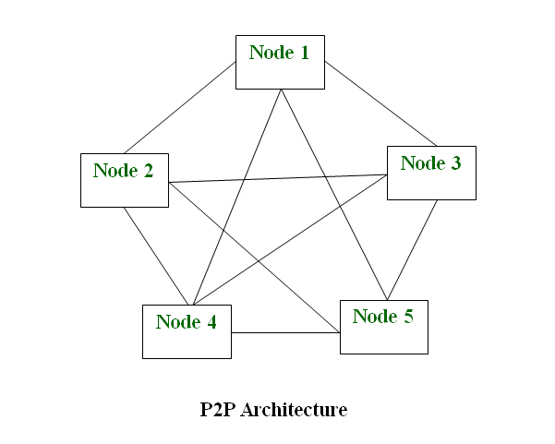
P2P Network Architecture
  In the P2P network architecture, the computers connect with each other in a workgroup to share files, and access to internet and printers.
  Each computer in the network has the same set of responsibilities and capabilities.
  Each device in the network serves as both a client and server.
  The architecture is useful in residential areas, small offices, or small companies where each computer act as an independent workstation and stores the data on its hard drive.
  Each computer in the network has the ability to share data with other computers in the network.
  The architecture is usually composed of workgroups of 12 or more computers.

